Slide 1






CARDIOVASCULAR
DISEASE PREDICTION
Group 5
Notes:
Hello, we are Group 5 and I will be talking about our project, predicting presence of cardiovascular disease.

Slide 2

INTRODUCTION
CARDIOVASCULAR DISEASE
Cardiovascular diseases are the leading cause of death worldwide and is estimated to causing 32% of all global deaths in 2019 (WHO)
Notes:
Now, what is cardiovascular disease? They are a group of disorders of the heart and blood vessels and include coronary heart disease and cerebrovascular disease, and other conditions. They are the leading cause of death worldwide and they are estimated to have caused 32% of global deaths in 2019.

Slide 3

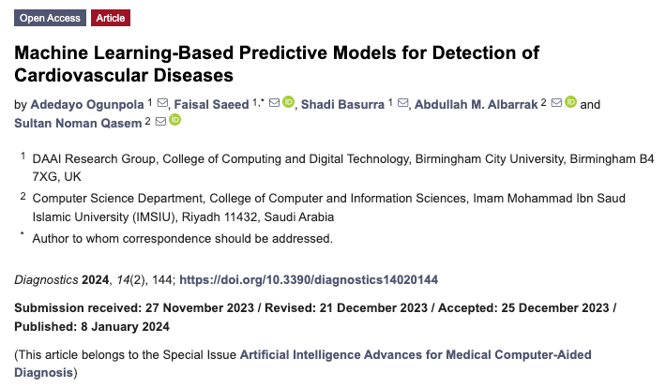
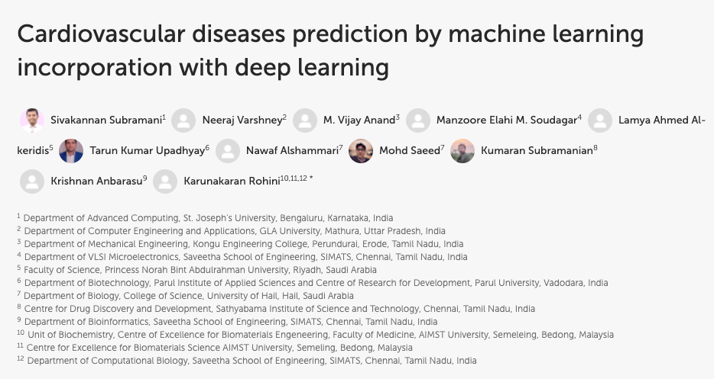
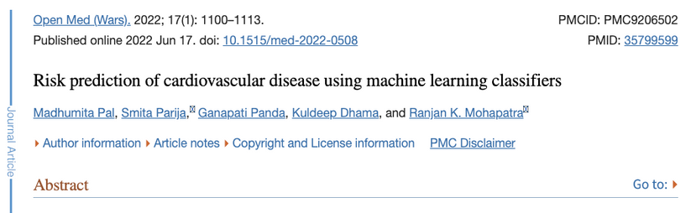

INTRODUCTION
Machine Learning is becoming a potent approach to prediction of cardiovascular disease
Notes:
With the improvement of AI, machine learning algorithms have taken the stage to successfully predict cardiovascular diseases. As we can see, there are numerous papers published on these attempts and show very successful results.

Slide 4
PROBLEM STATEMENT
“CAN MACHINE LEARNING ALGORITHMS PREDICT FOR CARDIOVASCULAR DISEASE AND TELL US THE FACTORS THAT CONTRIBUTE TO IT?”
Notes:
Thus, this brings us to our problem statement. Can Machine learning algorithms predict for cardiovascular disease and tell us the factors that contribute to it?. Let's now dive into the data we are going to be using for our project.

Slide 5







Our Dataset
CARDIOVASCULAR DISEASE DATASET
Consists of 70,000 patient records
FEATURES
Age (int)
Height (int)
Weight (float)
Gender (binary)
Systolic blood pressure (int)
Diastolic blood pressure (int)
Cholesterol (categorical)
Glucose (categorical)
Smoking (binary)
Alcohol intake (binary)
Physical activity (binary)
Cardio
The presence of Cardiovascular disease
Notes:
For our dataset, we used the cardiovascular disease dataset found on Kaggle.com. It consists of 70,000 patient records, with features as stated on the slide. There are a combination of various types of features and one binary target variable, which is the presence of cardiovascular disease in a patient.

Slide 6


DATA PREPARATION
REMOVING OUTLIERS
Interquartile Range
Q1 - 1.5 * IQR
Q3 + 1.5 * IQR
Q1
Q3
25th percentile
75th percentile
: outliers
Notes:
With our dataset, we put it through several operations. First of them was removing outliers. We defined outliers as those datapoints that lie outside of Q1 - 1.5 * interquartile range and Q3 + 1.5 * interquartile range, as shown in the slide.

Slide 7
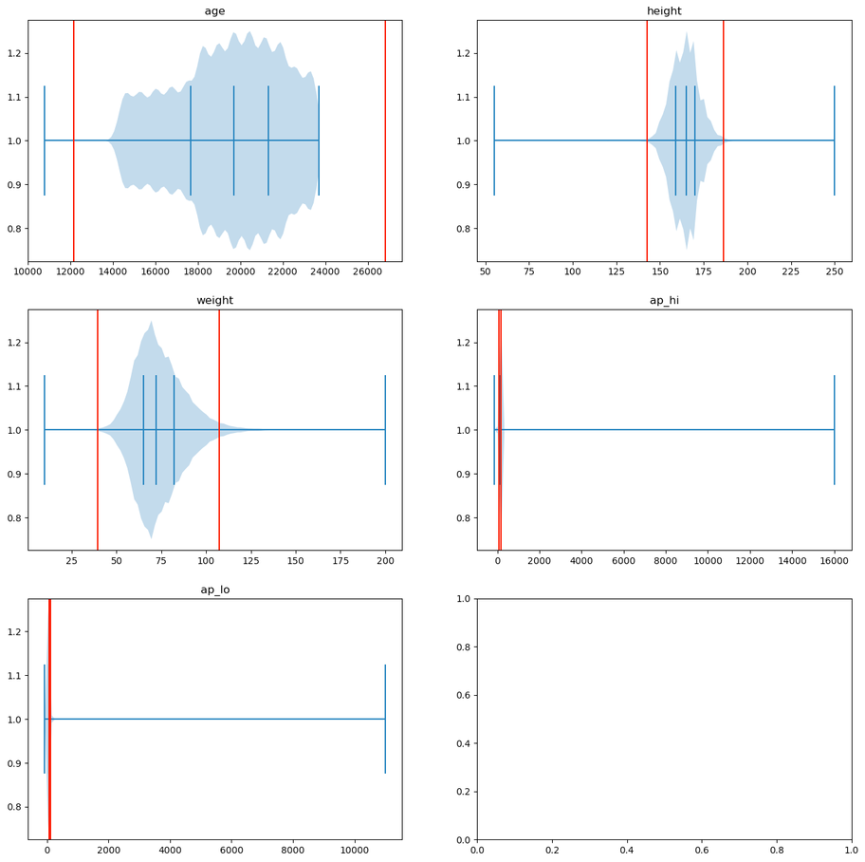
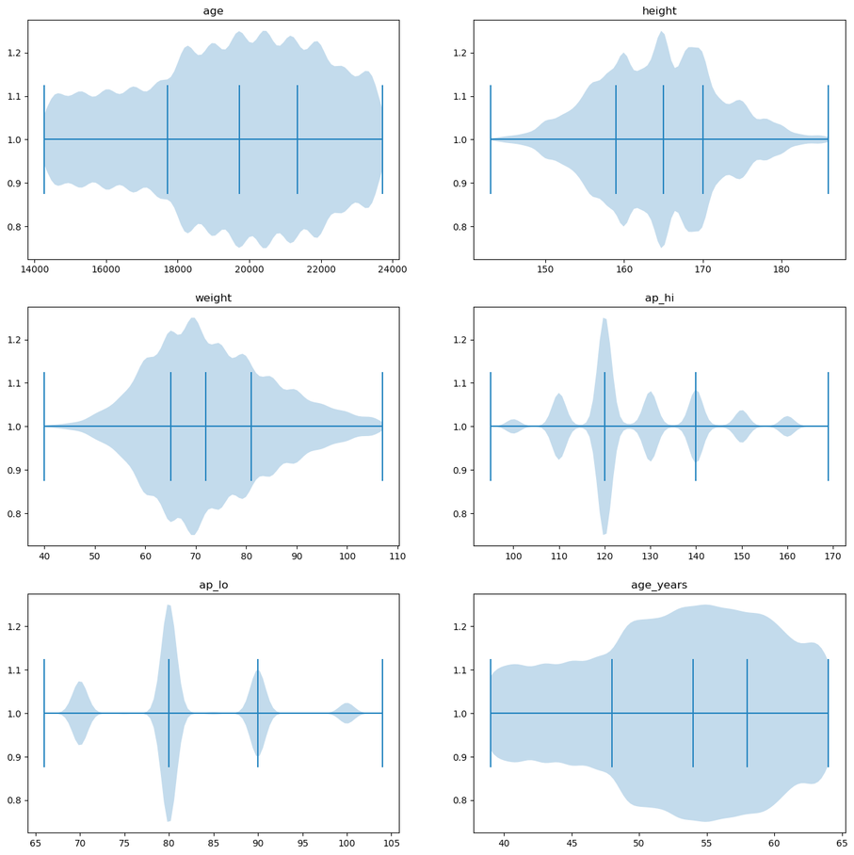
DATA PREPARATION
REMOVING OUTLIERS
Before Removal
After Removal
Notes:
Keeping the outlier calculation in mind, we gathered the continuous features in our dataset and calculated the outlier boundary. In the left hand side is our raw dataset, with the vertical red lines showing the outlier boundaries. Any datapoints beyond those 2 redlines are considered as outliers. After removing those outliers, we obtain the figure on the right hand side, which are those without any outliers. As we can see, they show a more evenly spread out dataset within a reasonable minimum and maximum limit.

Slide 8
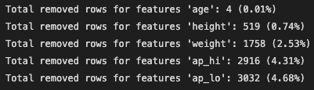
DATA PREPARATION
REMOVING OUTLIERS
Notes:
In total, we removed 8229 rows.

Slide 9








Data Preparation
ONE-HOT ENCODING
Turning categorical data into integer variables
01
Notes:
Another operation we applied on our data is one hot encoding. As we contain several categorical values, we utilized sklearn's one hot encoding technique to turn categorical data into integer variables.

Slide 10

EXPLORATORY
DATA ANALYSIS
Notes:
Now, let us look at the data after all of that preparation.

Slide 11

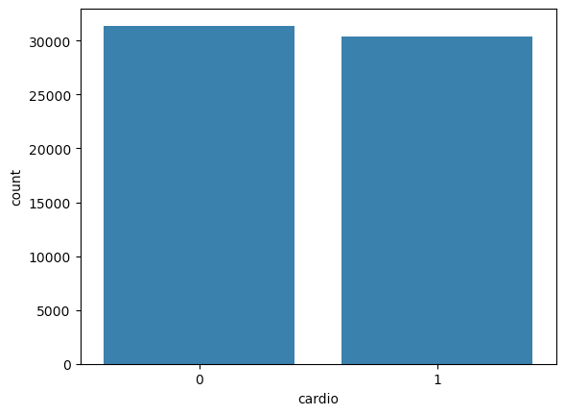


CARDIO VARIABLE
Balanced distribution of target variables - ‘cardio’
Notes:
Firstly let us look at our target variables, cardio. It shows a well balanced distribution even after removing all the outliers. With a balanced dataset, we won't need to worry about our machine learning algorithm leaning towards a specific target class.

Slide 12



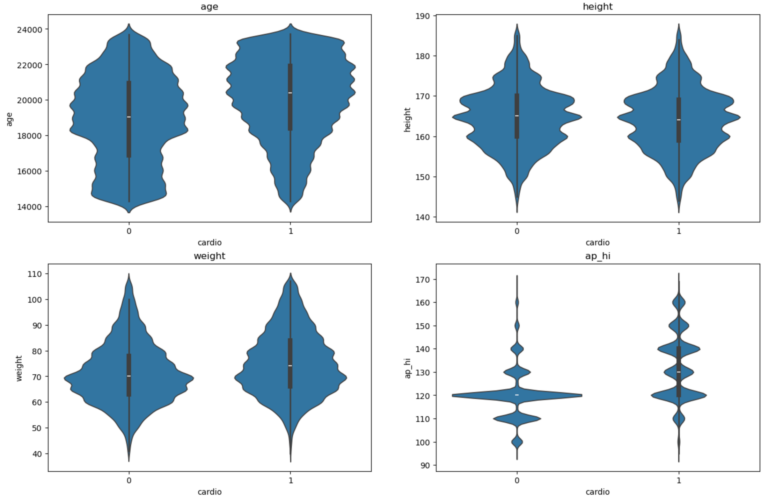
PLOTTING NUMERICAL VARIABLES WITH CARDIO
AGE
OBSERVATION
Cardio “1” shows higher median value of age
WEIGHT
OBSERVATION
Cardio “1” shows slightly higher median value of weight
Notes:
Now let us look at the other numerical variables compared to the target variable. With age and weight variable, we can see that cardio 1 shows a higher median value, indicating a potential to be a deciding factor for the target variable.

Slide 13
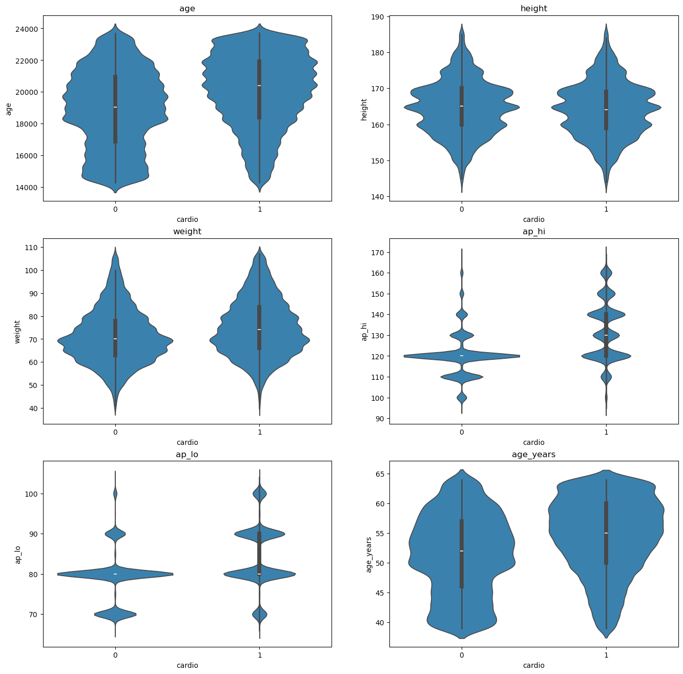
PLOTTING NUMERICAL VARIABLES WITH CARDIO
HEIGHT
OBSERVATION
Not much difference between the two cardio classes
Notes:
However, for the height variable, there does not seem to be much difference in distribution between the 2 cardio classes. This can mean that the height variable would not be playing a big part in our prediction.

Slide 14
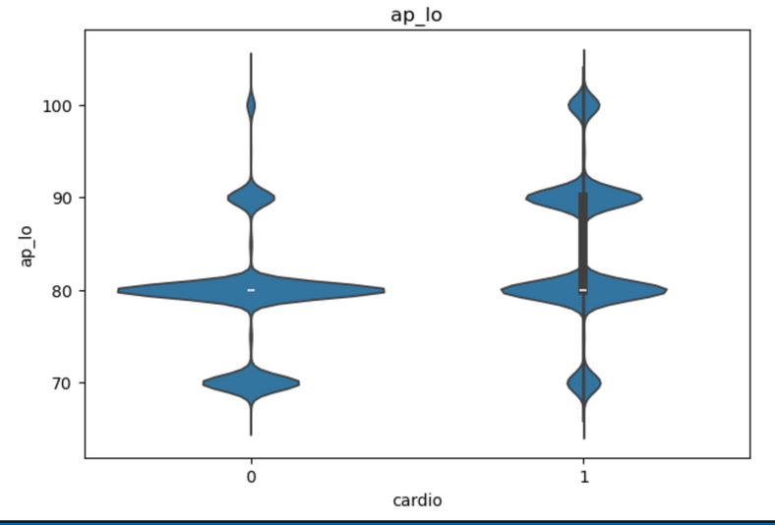
PLOTTING NUMERICAL VARIABLES WITH CARDIO
SYSTOLIC BLOOD PRESSURE
DIASTOLIC BLOOD PRESSURE
OBSERVATION
Cardio “1“ have more distribution at higher systolic blood pressure and diastolic blood pressure.
“High blood pressure (hypertension) significantly increases the risk of heart disease or stroke”
-Medical News Today
Notes:
For the blood pressure variables, it does seem like it will play a part in our prediction. Cardio 1 class can be observed to have greater distribution towards higher values of systolic blood pressure and diastolic blood pressure. This is a fact supported by medical science too as seen in the Medical News Today website where it mentions that high blood pressure significantly increases the risk of heart disease or stroke.

Slide 15

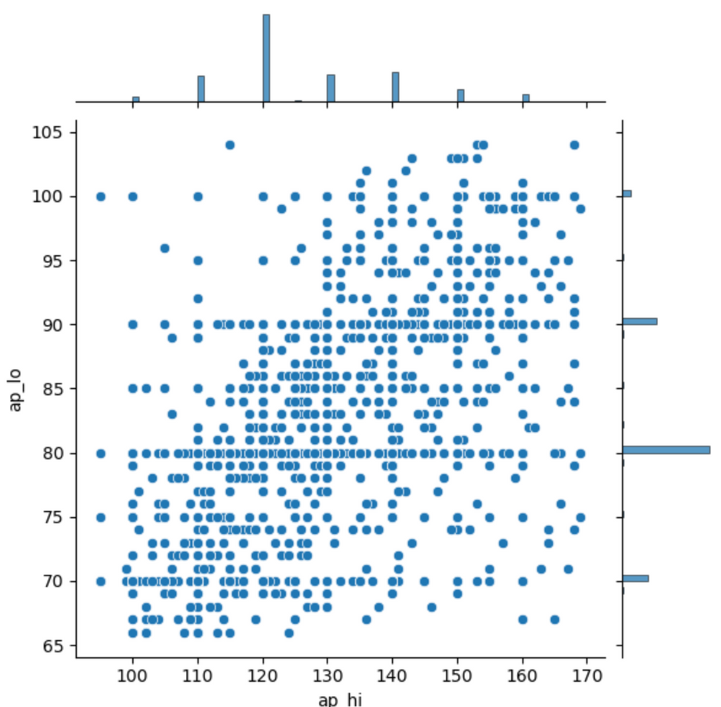

PEARSON CORRELATION
Check relation between Systolic & Diastolic blood pressure
DIASTOLIC
Pearson Correlation: 0.704
SYSTOLIC
Notes:
As just a check, we also checked the pearson correlation between systolic and diastolic blood pressure to check whether there is a high correlation between these two seemingly similar variables. However, visually and numerically, we concluded that these 2 variables are not as similar as we thought they might be as the correlation value stands at 0.7 and there does not seem to be a very distinct linear relationship. Therefore, we decided to just keep them both in our dataset.

Slide 16
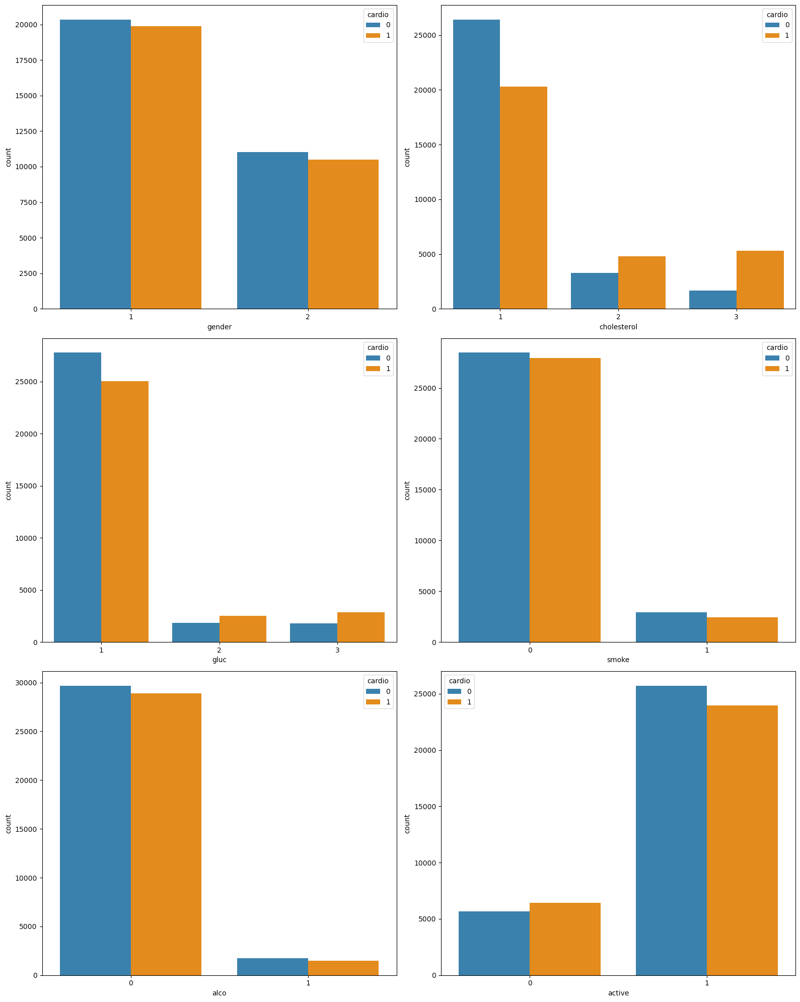

PLOTTING CATEGORICAL VARIABLES WITH CARDIO
CHOLESTEROL
ACTIVE LIFESTYLE
GLUCOSE LEVEL
OBSERVATION
The ‘cholesterol’, ‘gluc’ and ‘active’ variables affect the existence of cardio.
Difference in the proportion of cardio distribution in each class.
Notes:
Now let us look at the categorical variables. Amongst the categorical variables we plotted, cholesterol, glucose and active variables affect the existence of cardiovascular disease the most. As we can see, they show a substantial difference in the proportion of cardio distribution in each of its classes. For example, those who are in active class 1, there are lesser people with cardiovascular disease. However, those who are not active, have a higher percentage of people with cardiovascular disease.

Slide 17

MACHINE LEARNING
MODELS USED
Logistic Regression
Decision Tree Classifier
Random Forest Classifier
XGBClassifier
KNeighborsClassifier
Notes:
Now that we have explored the data and kept in mind which variables we believe would play a bigger role in our prediction, let us jump into the machine learning. We used a total of 5 models, Logistic Regression, Decision Tree Classifier, Random Forest Classifier, XGBClassifier, and Kneighborsclassifier.

Slide 18
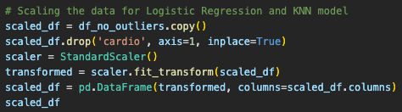
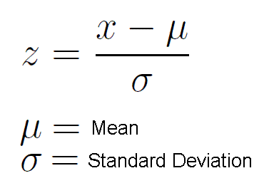
ADDITIONAL DATA PREPARATION
SCALING OF THE DATA USING SKLEARN’S STANDARDSCALER
Notes:
Firstly, we applied standardization to our dataset using the sklearn library. This function will deduct the mean and divide it by the standard deviation of our data to ensure the data will have a mean of 0 and unit variance.

Slide 19
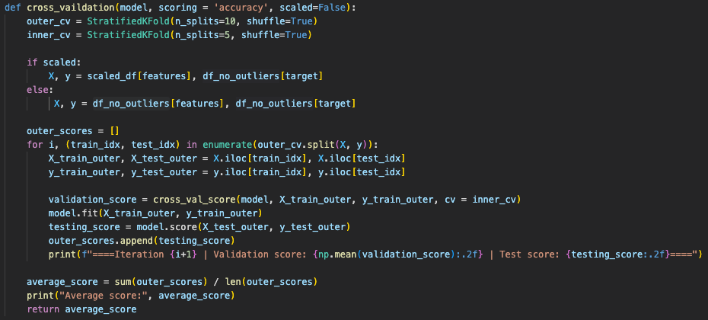

MODEL TRAINING LOOP
Outer loop
Inner Loop
Perform nested cross validation to test as diverse data combination.
Optimize models’ hyperparameters to ensure model is not tested with data used for hyperparameter tuning.
BENEFITS
Notes:
For our model training, we decided to employ a nested cross validation. This has 2 benefits. Firstly our model will be exposed to as much combination of data as possible. Secondly, it also benefits our hyperparameter tuning later on, as our models' hyperparameters would be tuned on the validation data and would then be tested on the testing dataset, preventing overfitting and any testing information from leaking into the data.

Slide 20
NESTED CROSS VALIDATION
test
train
Notes:
For our nested cross validation, we employed a ten fold for our outer loop and a five fold for our inner loop. As we can see, for every outer loop, we would then split the outer training dataset into 5 parts, where we would carry out our inner training loop. This would ensure that our total dataset is split into training, validation and testing datasets.

Slide 21
RESULTS
Logistic Regression, XGBClassifier and KNeighborsClassifier seems to perform the best.
(ACCURACY)
Logistic Regression | Decision Tree | Random Forest
0.721 | 0.625 | 0.708
XGBClassifier | KNeighborsClassifier
0.724 | 0.721
Notes:
For the results, we can observe that Logistic Regression, XGBClassifier and KNeighborsClassifier perform the best. For our other 2 models, Decision Tree and Random Forest, they lose out to XGBClassifier, a similar ensembling method.
This could potentially be due to the fact that XGBClassifier employs superior methods in its algorithm such as bagging and gradient boosting, improving on its weaker models while also ensuring minimal overfitting.

Slide 22
HYPERPARMETER
TUNING
MODELS TUNED
Logistic Regression
XGBClassifier
KNeighborsClassifier
Notes:
Now that know which models perform the best on our data, so we proceed onto hyperparameter tuning for these 3 models.

Slide 23
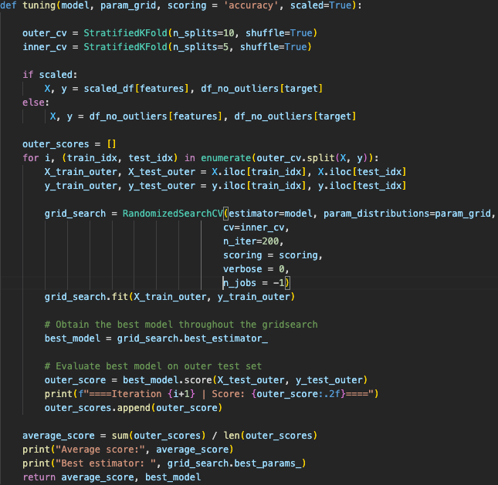

HYPERPARAMETER TUNING LOOP
Hyperparameters are tuned using the inner loop
Outer Loop
models are tested on the outer testing data
Inner Loop
TO
prevent leakage of data and overfitting
Notes:
As mentioned earlier, we utilize a nested cross validation to tune our hyperparameter on the validation dataset and then test our tuned model on the test dataset, which our model would have never seen before, ensuring there is no information leak and no overfitting.

Slide 24
HYPERPARAMETER TUNING
Logistic Regression | XGBClassifier | KNeighborsClassifier
0.721 | 0.724 | 0.721
Logistic Regression | XGBClassifier | KNeighborsClassifier
0.721 | 0.728 | 0.722
Notes:
With hyperparameter tuning, we were successful in improving XGBClassifier and KneighborsClassifier model by a small margin. The reason for the lacklustre improvement in Logistic Regression is most likely due to the fact that logistic regression is rather a simple model with its core functionality already well defined prior to any tuning procedure. Additionally, the overall miniscule improvement in accuracy usually is an indication that there is not much room for models to improve anymore, so there should be more attention on the quality and quantity of the dataset.

Slide 25





INSIGHTS
Notes:
Now, let us look at some of the observation and see what insights we can obtain.

Slide 26
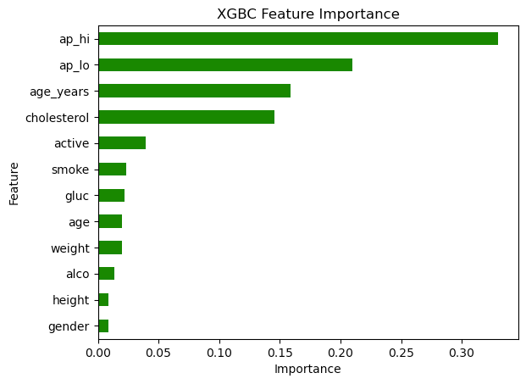
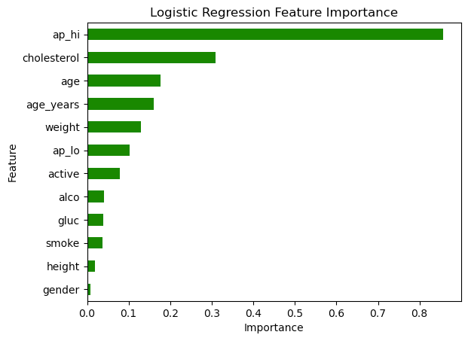
FEATURE IMPORTANCE
Notes:
Feature importance is an importance part of the model we should pay attention to. For our logistic regression and XGBClassifier model, these are the feature importance. For our Kneighborsclassifier, there is no feature importances provided as it is a non-parametric model, meaning it doesn't inherently assign weights or feature importance scores during classification.

Slide 27

FEATURE IMPORTANCE
‘ap_hi’ has the greatest feature importance
Clear distinction between the cardio classes for ‘ap_hi’ feature.
More higher ap_hi values for Cardio class “1” and higher median value.
Notes:
As we can observe from the previous slide, ap_hi has the greatest feature importance. As observed earlier in our EDA, there is a clear distinction between the cardio classes for ap_hi feature with more concentration of higher ap_hi values for class 1 for the cardio variable.

Slide 28
FEATURE IMPORTANCE
‘‘cholesterol’ also shows great importance
clear distinction of distribution between ‘cardio’ classes.
EX: 5 times more cardio “1” compared to cardio “0” for cholesterol Lvl 3
Notes:
Additionally, cholesterol also shows great importance. We can see very clear distinction of distributions of cardio classes amongst cholesterol 1, 2 and 3. This goes to prove our initial hypothesis saying that blood pressure and cholesterol are amongst those features that could play a big part in our predictions.

Slide 29
FEATURE IMPORTANCE
'height’ variable plays ALMOST NO PART
IN LINE
INITIAL PREDICTION using EDA:
Height shows no distinctive pattern across the 2 DIfferent cardio classes
Notes:
Also to prove our hypothesis, we can also see from the feature importances that height does not play a significant part in our prediction. This is in line with our initial prediction using EDA that height shows no distinctive pattern across the 2 different cardio classes.

Slide 30
FEATURE IMPORTANCE
Age and cholesterol are both significant figures.
Blood pressure plays a BIG ROLE in the presence of cardiovascular disease
(supported by biological knowledge)
THE HIGHER the AGE, the greater the chance of cardiovascular disease
THE Greater the cholesterol, the greater the chance of cardiovascular disease
People who are older, with higher cholesterol and higher blood pressure should take measures early to prevent cardiovascular disease.
Notes:
We can see from previous slides that blood pressure, age and cholesterol plays a significant part in the presence of cardiovascular disease. Thus, we can conclude that people who are older, with higher cholesterol and higher blood pressure should take measures early to prevent cardiovascular disease.

Slide 31
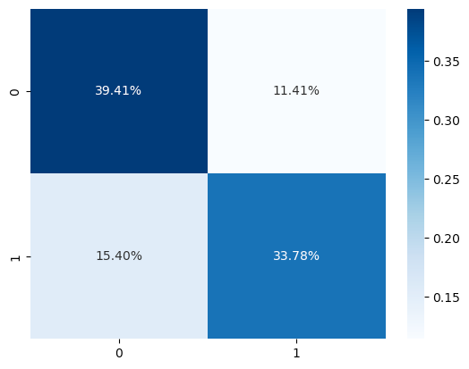
CONFUSION MATRIX
F1 score ~ 0.7
false negatives > false positives, which could be pretty dangerous in a healthcare scenario.
High false positive suggests large volume of inefficiencies
High false negatives, can endanger patients by missed treatment opportunities.
There is room for improvement
XGBCLASSIFIER
Notes:
Lastly, we take a look at the confusion matrix of the XGBClassifier model. The F1 score sits at around 0.7 and we can see that there are more false negatives than false positives, which could be pretty dangerous in a healthcare scenario. With a high false positive rate, it would be a matter of inefficiencies. However, a large false negative rate could spell danger for patients as they could miss crucial operations and let their health deteriorate further. This confusion matrix thus shows that our models have room for improvement.

Slide 32
THANK YOU!
Notes:
That brings us to the end of our presentation. Thank you!

